Slide 1

Study Buddy By Oreoluwa Williams, Riley Forney, Areli Morales Hernandez, Addison Giffin & Muteeb Younus.

Slide 2
Agenda
Introduction: What is Study Buddy?
Main Features/Use Cases
Front End
AI/ML Integration
Back End & Database
Adaptability/Future Work
Demo

Slide 3
Intro: What is Study Buddy?
A web application designed to help Towson students find study groups & partners.
Study Buddy is a dedicated platform created only for Towson University students to better tailor to their needs.
This creates a one stop app for study groups and allows communicating with classmates.
By providing a centralized platform tailored to unique needs, this application aims to streamline the process of finding study groups or partners, thereby enhancing the collaborative learning experience.

Slide 4
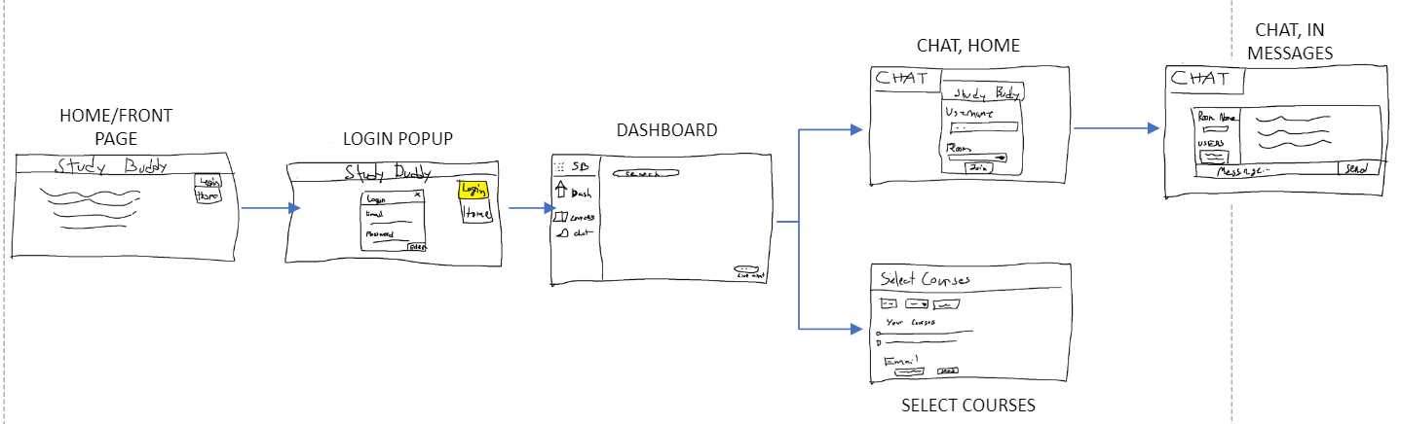
Main Features/Use Cases
Create Account/Log in.
Add classes to accounts
Email people in a class.
Campus specific AI for assistance in scheduling rooms for group meetings.
Database to keep track of user logins, class data, and authentication.
Live Chat Application.

Slide 5
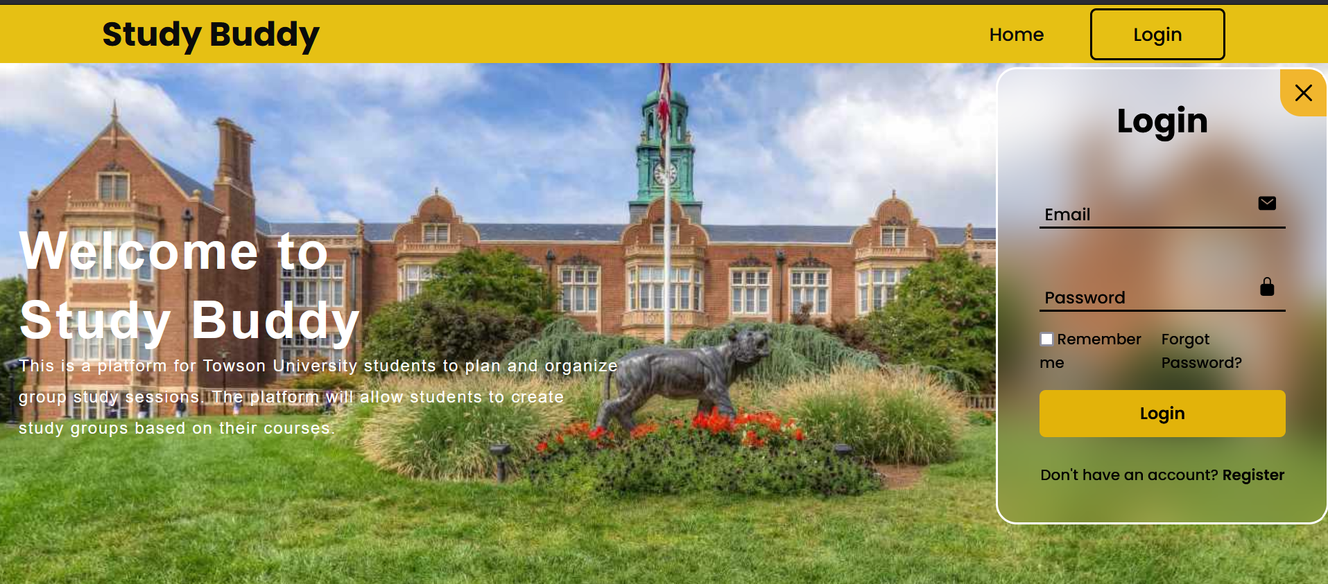
Front End
Our frontend uses:
CSS (for design)
html (for structure)
JavaScript (for functionality)

Slide 6
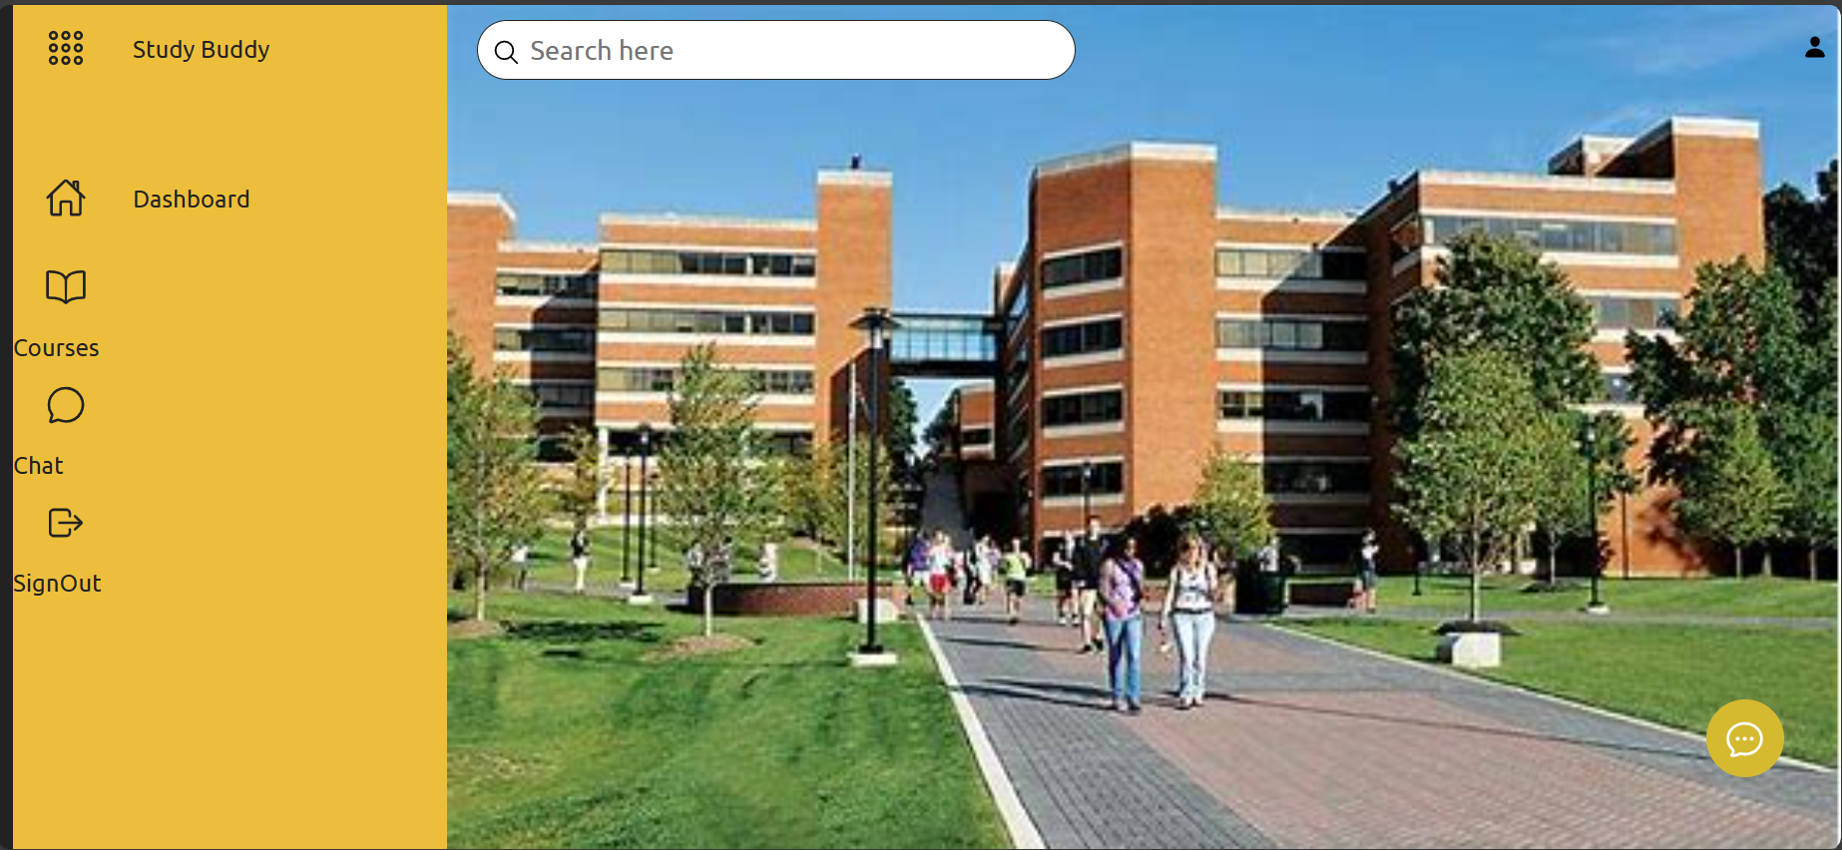
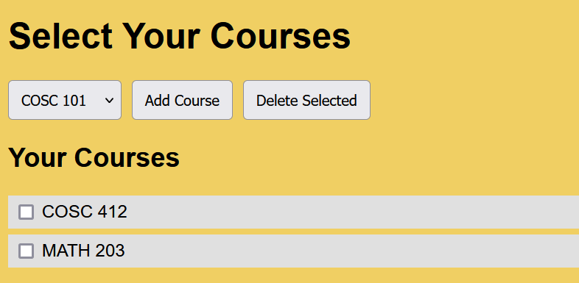
Screenshots of Front End

Slide 7
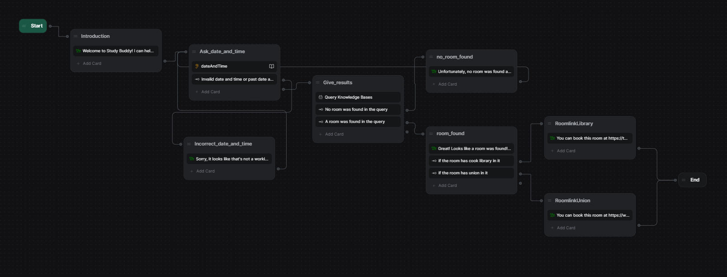

AI/ML Integration
Notes:
-Had trouble initially thinking of an AI integration, but professor gave us the idea
-Unfortunately, could not find a way to tap into Towson's databases, so made a fake database
-Used Botpress
-Block-based AI building, allowing lots of customization

Slide 8
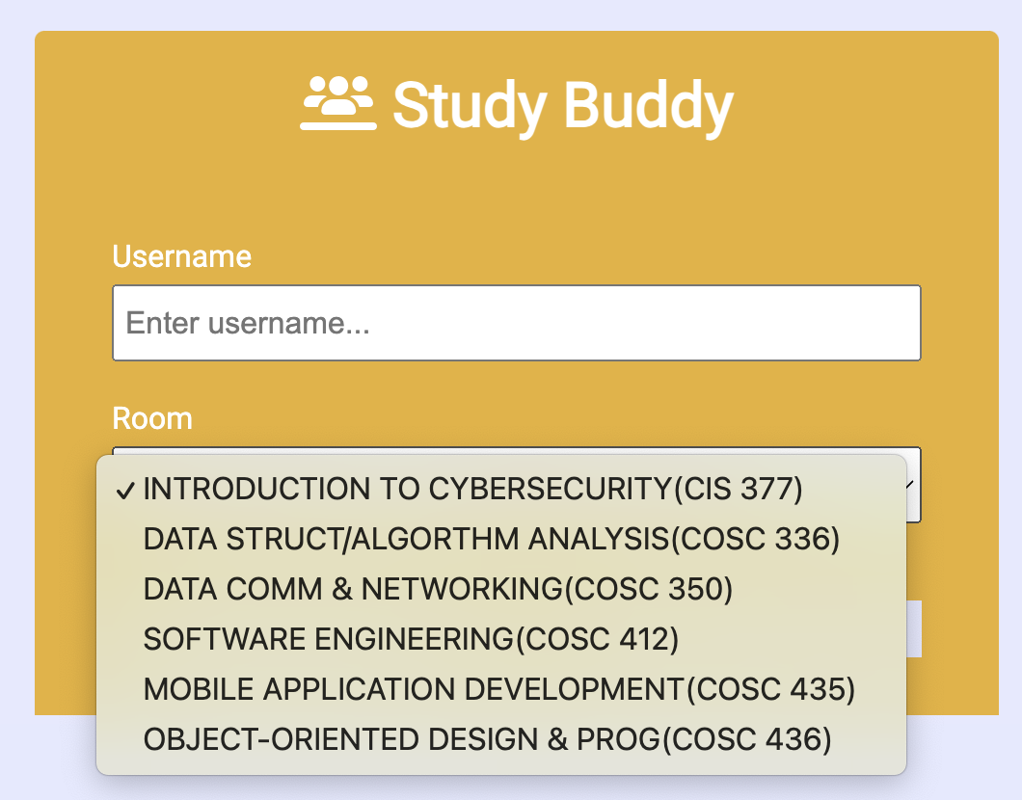
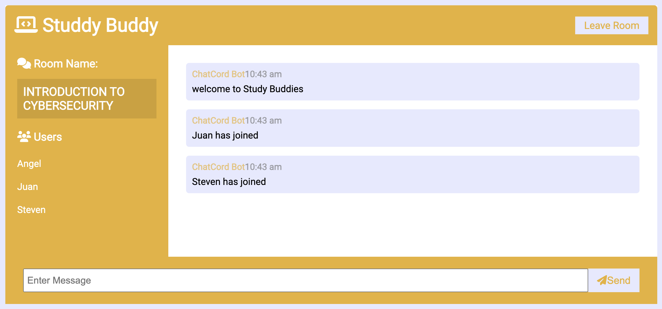
Chat Application

Slide 9
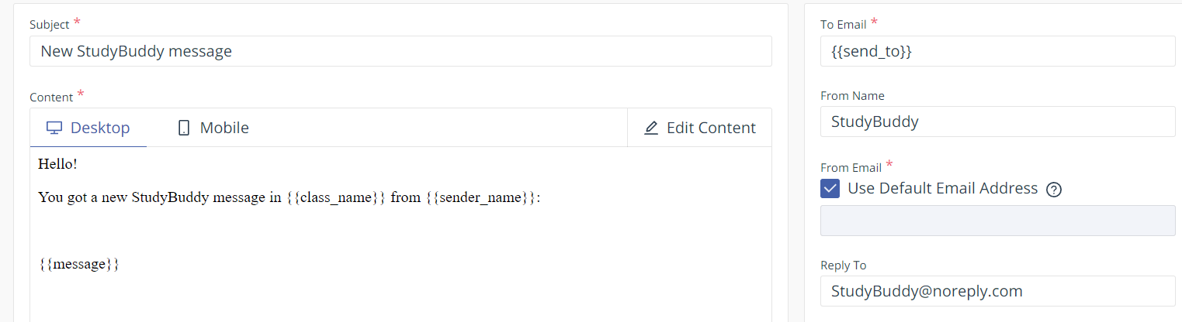
Email System
EmailJS
Allows users to message everyone who has added a specific class to their account
Follows a clean and recognizable template

Slide 10

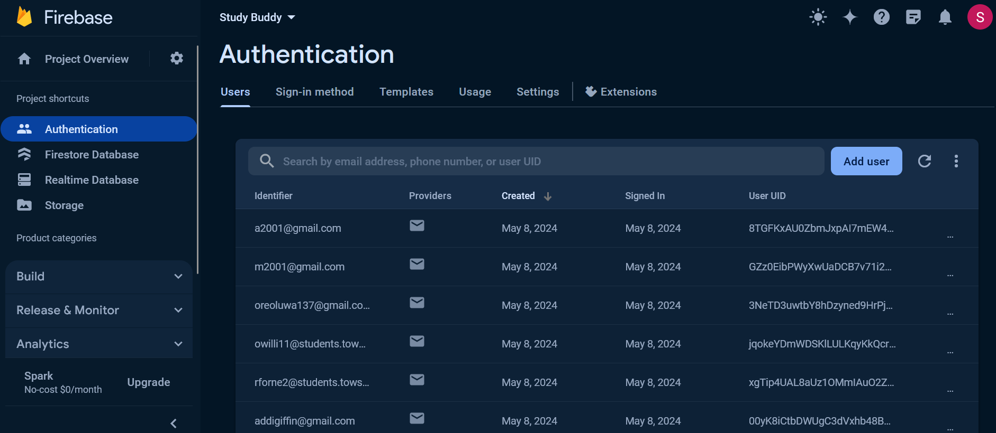
Back End & Database
Used Firebase for our back end and API
cloud hosted NoSQL database
Used to store user & class data.
Login in/Authentication is run on Firebase
Allows scalability
Engagement/usage runs through Firebase Analytics

Slide 11

Adaptability
Database designed to be very modular so that classes can easily be added or removed
The chat was also designed with this modularity in mind
Future intentions are to scale and increase coverage of rooms and classes
Future Work
Getting the live chat feature working
Include real databases
Increase the list of classes
Upgrading services for more bandwidth/traffic

Slide 12
Demo
Github Repository Link:
https://github.com/owilli04/cosc412_project/tree/main
Link to the website:
https://owilli04.github.io/cosc412_project/studyBuddy/index.html

Slide 13
Thank You!

